Slide 1
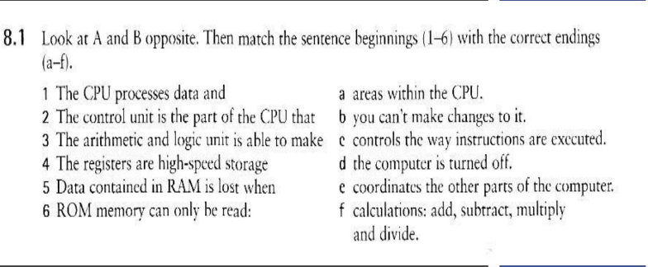
TASK N°8
Renzo Neyra Quesquen
3-f

Slide 2
8.2. Solve the clues and complete the puzzle with words from the opposite page.
1. Intel ______ are used in many computers.
2. Each 0 or 1 is called a bit, short for ______ digit.
3. Special cards can be inserted into expansion ______.
4. A ______ controls the timing within the PC by sending signals to synchronize its circuirs and operations.
5. The processor speed is measured in ______.
6. ______ carry signals berween different parts of a PC.
7. ______ cards improve the computer's performance.
8. The ______ uses ROM to control the input/output of data.
9. The main printed circuit board is called the ______.

Slide 3
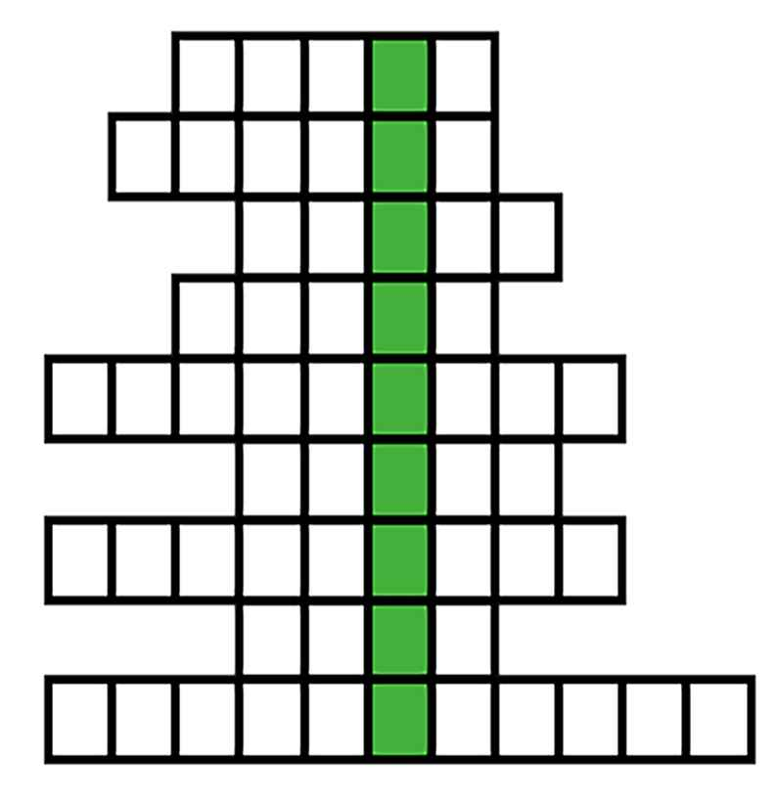
C
H
I
P
S
RESOLVE
CHIPS
BINARY
SLOTS
CLOCK
GIGAHERTZ
BUSES
EXPANSION
BIOS
MOTHERBOARD
DOWN: THE BRAIN OF A COMPUTER “PROCESSOR”
B
I
N
A
R
Y
S
L
O
T
S
C
L
O
C
K
G
I
G
A
H
E
R
T
Z
B
U
S
E
S
E
X
P
A
N
S
I
O
N
B
I
O
S
Renzo Neyra Quesquen
M
O
T
H
E
R
B
O
A
R
D

Slide 4
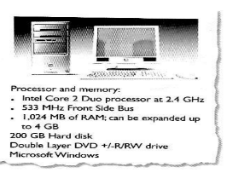
8.3. Read this product and answer the questions below. description
1.How fast is the CPU?
The CPU is clocked at 2.4 GHz.
2. Which term is used to describe the CPU data bus?
The term used is "533 MHz Front Side Bus".
3. How much RAM does the computer have?
The computer has 1 GB of RAM.
4.Can you add extra RAM chips? How many?
Yes, extra RAM chips can be added. The computer can be expanded up to 4 GB of RAM.

